Slide 1
INFORMATION GATHERING

Slide 2
Conduct Search Engine Discovery for Information Leakage
Identify what configuration information of the application, system, or organization by search engine
Some search engines: Bing, google,…
Way to search:
+ Search Operators
+ Viewing Cached Content
+ Google Hacking, or Dorking

Slide 3
Fingerprint Web Server, Web Application Framework
Determine the version and type of a running web server to enable further discovery of any known vulnerabilities.
Way to test:
+ Banner Grabbing
+ Sending Malformed Requests
+ Using Automated Scanning Tools (Netcraft, Nikto, Nmap)
+ Some tool for frameword:
+ Whatweb
+ Wappalyzer

Slide 4
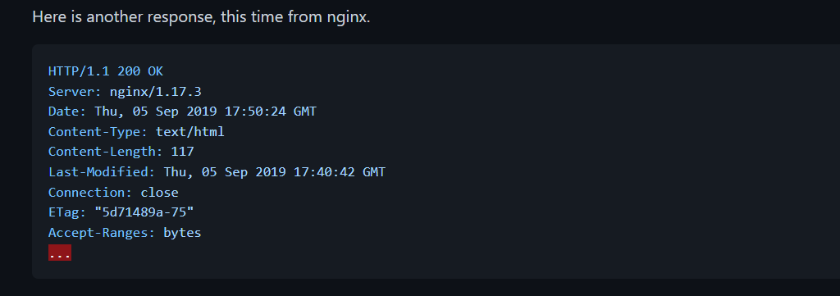
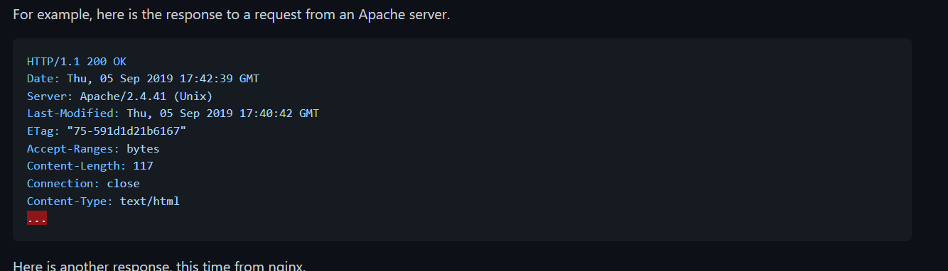
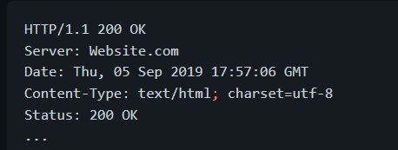
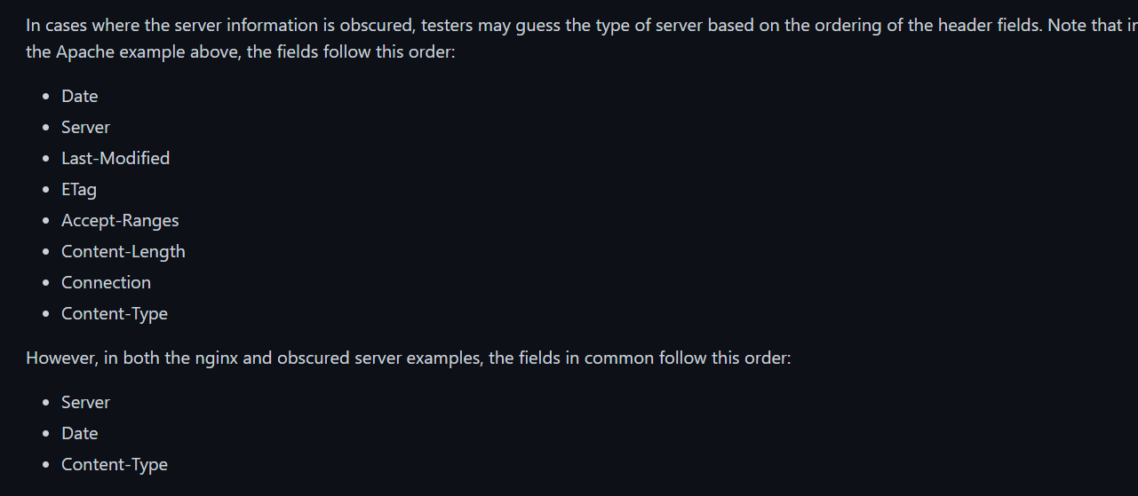

Slide 5
Review Webserver Metafiles for Information Leakage
Identify hidden or obfuscated paths and functionality through the analysis of metadata files.
Extract and map other information that could lead to a better understanding of the systems at hand.
Some ways to test:
+ Robots.txt
+ META Tags
+ Sitemaps
+ Security TXT

Slide 6
Enumerate Applications on Webserver
Enumerate the applications within the scope that exist on a web server.
Ways to test:
+ Different Base URL
+ Non-standard Ports
+ Virtual Hosts
- DNS zone transfer
- DNS inverse quẻies
- Reverse-IP lookup

Slide 7
Review Webpage Content for Information Leakage
Review webpage comments, metadata, and redirect bodies to find any information leakage.
Gather JavaScript files and review the JS code to better understand the application and to find any information leakage.
Identify if source map files or other front-end debug files exist.
Ways to test:
+ Review Webpage Comments and Metadata
+ Identifying JavaScript Code and Gathering JavaScript Files
+ Identifying Source Map Files
+ Identify Redirect Responses which Leak Information

Slide 8
Identify Application Entry Points
Identify possible entry and injection points through request and response analysis.
Ways to test:
+ Blackbox testing
+ Graybox
+ Tools:
+ Burp Suite
+ Fidder
+ OWASP Attack Surface Detector

Slide 9
Map Execution Paths Through Application
Map the target application and understand the principal workflows.
Ways to test:
+ Path
+ Data Flow (or Taint Analysis)
+ Race
+ Tools: Automatic Spidering
+ Zed Attack Proxy (ZAP)
+ List of spreadsheet software
+ Diagramming software

Slide 10
Map Application Architecture
Understand the architecture of the application and the technologies in use.
+ Application Components
+ Web Server
+ Static Storage
+ Network Components
+ Reverse Proxy
+ Load Balancer
+ Security Components
+ Network Firewall
+ Web Application Firewall (WAF)

